Slide 1
Advanced Specs For Visually Challenged
By Govind A & Ashwin Bose

Slide 2
Features
Self-Recognizing Virtual Braille Script (Text to Speech)
Face-Mask Recognition
Obstacle Sensing
Uneven Surface Aiding System
Emergency Photo Service
Audio Assistance

Slide 3
Components
Python-Based Single Board Computer Chip
Lithium Battery x 3
Button Switch x 3
Camera Module
Earphone capsule
Ultrasonic Sensor x 2
Ultrasonic Detector
Memory Card
Battery Charging Port
3D-Printed Polymer Frame

Slide 4
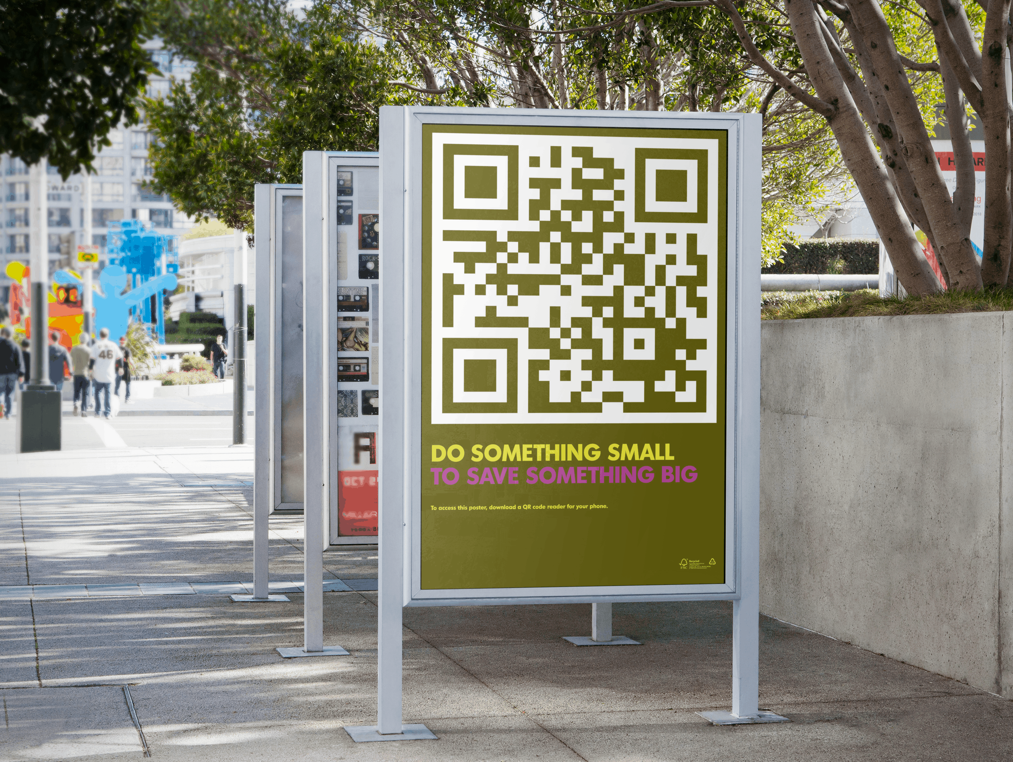
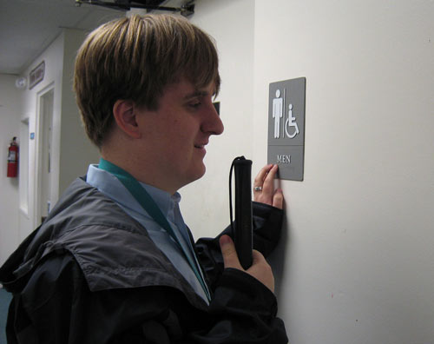
WHY?
Self-Recognizing Virtual Braille Script (Text to Speech)
GO
CONTACTLESS

Slide 5
HOW?

Slide 6
START
ACTIVATE
Ultrasonic Detector
Checks pressure of XXXMhz frequency around 5m radius
Using pyttsx3 library, audio command start with four navigation command
Till it reaches 40cm is front of the code
Scan the QR code to Text by pyzbar module in python
Using pyttsx 3 module, the text is changed into speech
WAIT FOR 2 SECONDS
If POWER BUTTON PRESSED
STOP
no
yes
no
yes

Slide 7
#READING AND UNDERSTANDING QR CODE import cv2 from pyzbar.pyzbar import decode capture = cv2.videocapture(0) #DEFAULT CAMERA while True: _, instantpic = capture.read() decodeddata = decode(instantpic) NETDATA = decodeddata[0][0] #FOR ACCESING THE TEXT PART ONLY cv2.imshow("qr",instantpic) key = cv2.waitKey(5) if key == ord(POWER HANDLE): #FIRST RED SWITCH break #to read out text from _tkinter import * import pyttsx3 engine = pyttsx3.init() engine.say(NETDATA) engine.runAndWait()

Slide 8
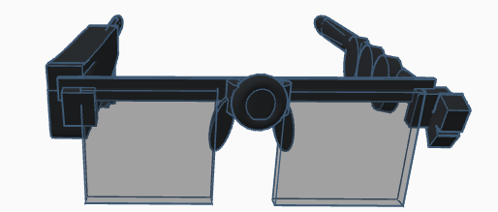
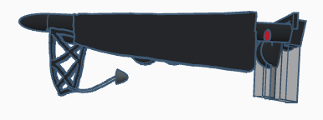
Camera
Power Handle
Earphone

Slide 9
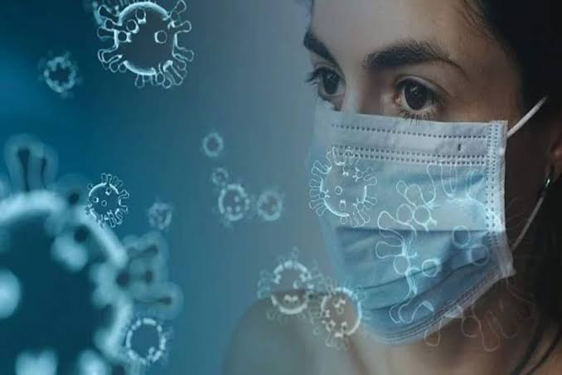
WHY?
Face-Mask Recognition

Slide 10
HOW?

Slide 11
START
Open camera and access with open cv library module
Send each frame to neutral network
It is normalised to 10*10 image size and colour are normalised
NEURAL NETWORK using keras
If Human Face Detected
If Wearing Mask?
“Please keep distance no Mask” is dictated using pyttsx3
If POWER BUTTON pressed
STOP
POWER BUTTON
no
Trained data after normalising 100 pictures each with and without mask
yes
no
yes
no
yes

Slide 12
#FACEMASK RECOGNITON import cv2, os data_path = 'dataset' categories = os.listdir(data_path) labels = [i for i in range(len(categories))] label_dict = dict(zip(categories, labels)) # empty dictionary print(label_dict) print(categories) print(labels) {'with mask': 0, 'without mask': 1} ['with mask', 'without mask'] [0, 1] img_size = 100 data = [] target = [] for category in categories: folder_path = os.path.join(data_path, category) img_names = os.listdir(folder_path)
for img_name in img_names: img_path = os.path.join(folder_path, img_name) img = cv2.imread(img_path)

Slide 13
try: gray = cv2.cvtColor(img, cv2.COLOR_BGR2GRAY) #MAKING IT GREY AND 10*10 TO MAKE IT EASIER TO DIGEST FOR TRAINING data.append(resized) target.append(label_dict[category]) import numpy as np data = np.array(data) / 255.0 data = np.reshape(data, (data.shape[0], img_size, img_size, 1)) target = np.array(target) import numpy as np data=np.load('data.npy') target=np.load('target.npy') #NEURAL NETWORK from keras.models import Sequential from keras.layers import Dense,Activation,Flatten,Dropout from keras.layers import Conv2D,MaxPooling2D from keras.callbacks import ModelCheckpoint

Slide 14
model=Sequential() model.add(Conv2D(200,(3,3),input_shape=data.shape[1:])) model.add(Activation('relu')) model.add(MaxPooling2D(pool_size=(2,2))) #The first CNN layer followed by Relu and MaxPooling layers model.add(Conv2D(100,(3,3))) model.add(Activation('relu')) model.add(MaxPooling2D(pool_size=(2,2))) #The second convolution layer followed by Relu and MaxPooling layers model.add(Flatten()) model.add(Dropout(0.5)) #Flatten layer to stack the output convolutions from second convolution layer model.add(Dense(50,activation='relu')) #Dense layer of 64 neurons model.add(Dense(2,activation='softmax')) #The Final layer with two outputs for two categories model.compile(loss='categorical_crossentropy',optimizer='adam',metrics=['accuracy']) from sklearn.model_selection import train_test_split

Slide 15
#TRAINING WITH THE DATA train_data,test_data,train_target,test_target=train_test_split(data,target,test_size=0.1) checkpoint = ModelCheckpoint('model-{epoch:03d}.model',monitor='val_loss',verbose=0,save_best_only=True,mode='auto') history=model.fit(train_data,train_target,epochs=20,callbacks=[checkpoint],validation_split=0.2) Train on 990 samples, validate on 248 samples Epoch 1/20 990/990 [==============================] - 93s 94ms/step - loss: 0.7326 - accuracy: 0.5626 - val_loss: 0.5822 - val_accuracy: 0.6290 Epoch 2/20 990/990 [==============================] - 93s 94ms/step - loss: 0.5465 - accuracy: 0.7253 - val_loss: 0.4429 - val_accuracy: 0.8185 Epoch 3/20 990/990 [==============================] - 93s 94ms/step - loss: 0.3708 - accuracy: 0.8354 - val_loss: 0.2568 - val_accuracy: 0.9032 Epoch 4/20 990/990 [==============================] - 95s 96ms/step - loss: 0.2679 - accuracy: 0.8970 - val_loss: 0.1807 - val_accuracy: 0.9476 Epoch 5/20 990/990 [==============================] - 93s 94ms/step - loss: 0.1917 - accuracy: 0.9303 - val_loss: 0.2207 - val_accuracy: 0.9315 Epoch 6/20 990/990 [==============================] - 93s 94ms/step - loss: 0.1749 - accuracy: 0.9343 - val_loss: 0.1249 - val_accuracy: 0.9597 Epoch 7/20 990/990 [==============================] - 95s 96ms/step - loss: 0.1238 - accuracy: 0.9576 - val_loss: 0.1258 - val_accuracy: 0.9637 Epoch 8/20 990/990 [==============================] - 94s 95ms/step - loss: 0.1037 - accuracy: 0.9616 - val_loss: 0.1243 - val_accuracy: 0.9516 Epoch 9/20 990/990 [==============================] - 94s 95ms/step - loss: 0.0893 - accuracy: 0.9687 - val_loss: 0.1095 - val_accuracy: 0.9556 Epoch 10/20 990/990 [==============================] - 94s 95ms/step - loss: 0.0540 - accuracy: 0.9828 - val_loss: 0.1193 - val_accuracy: 0.9597

Slide 16
Epoch 11/20 990/990 [==============================] - 92s 93ms/step - loss: 0.0399 - accuracy: 0.9899 - val_loss: 0.1278 - val_accuracy: 0.9677 Epoch 12/20 990/990 [==============================] - 93s 94ms/step - loss: 0.0518 - accuracy: 0.9818 - val_loss: 0.0974 - val_accuracy: 0.9718 Epoch 13/20 990/990 [==============================] - 96s 97ms/step - loss: 0.0615 - accuracy: 0.9778 - val_loss: 0.1604 - val_accuracy: 0.9274 Epoch 14/20 990/990 [==============================] - 97s 98ms/step - loss: 0.0589 - accuracy: 0.9828 - val_loss: 0.0863 - val_accuracy: 0.9597 Epoch 15/20 990/990 [==============================] - 94s 95ms/step - loss: 0.0411 - accuracy: 0.9808 - val_loss: 0.0998 - val_accuracy: 0.9677 Epoch 16/20 990/990 [==============================] - 81s 82ms/step - loss: 0.0547 - accuracy: 0.9747 - val_loss: 0.0899 - val_accuracy: 0.9556 Epoch 17/20 990/990 [==============================] - 79s 80ms/step - loss: 0.0372 - accuracy: 0.9889 - val_loss: 0.0855 - val_accuracy: 0.9637 Epoch 18/20 990/990 [==============================] - 78s 79ms/step - loss: 0.0301 - accuracy: 0.9879 - val_loss: 0.1107 - val_accuracy: 0.9556 Epoch 19/20 990/990 [==============================] - 89s 90ms/step - loss: 0.0206 - accuracy: 0.9919 - val_loss: 0.0947 - val_accuracy: 0.9677 Epoch 20/20 990/990 [==============================] - 94s 95ms/step - loss: 0.0358 - accuracy: 0.9899 - val_loss: 0.1575 - val_accuracy: 0.9476

Slide 17
#PLOTTING THE NEURAL THE DATA OF ACCURACY FROM TRAING LOSS DATA STRUCTURE from matplotlib import pyplot as plt plt.plot(history.history['loss'],'r',label='training loss') plt.plot(history.history['val_loss'],label='validation loss') plt.xlabel('# epochs') plt.ylabel('loss') plt.legend() plt.show() plt.plot(history.history['accuracy'],'r',label='training accuracy') plt.plot(history.history['val_accuracy'],label='validation accuracy') plt.xlabel('# epochs') plt.ylabel('loss') plt.legend() plt.show() print(model.evaluate(test_data,test_target)) 138/138 [==============================] - 6s 44ms/step [0.14019694376358952, 0.9637681245803833]

Slide 18
#RECIPROCATE THE TRAINED NETWORK AGAINST REALTIME CAMERA PLOT model = load_model('model-017.model')
face_clsfr=cv2.CascadeClassifier('haarcascade_frontalface_default.xml') source=cv2.VideoCapture(2) labels_dict={0:'MASK',1:'NO MASK'} while (True): ret, img = source.read() gray = cv2.cvtColor(img, cv2.COLOR_BGR2GRAY) faces = face_clsfr.detectMultiScale(gray, 1.3, 5) for (x, y, w, h) in faces: face_img = gray[y:y + w, x:x + w] resized = cv2.resize(face_img, (100, 100)) normalized = resized / 255.0 reshaped = np.reshape(normalized, (1, 100, 100, 1)) result = model.predict(reshaped) label = np.argmax(result, axis=1)[0] if labels_dict = 1: import pyttsx3 engine.say("PLEASE KEEP DISTANCE NO MASK") key = cv2.waitKey(2) if key == ord("POWER HANDLE"): BREAK

Slide 19
Camera
Power Handle
Earphone

Slide 20
WHY?
Obstacle Sensing

Slide 21
HOW?

Slide 22
START
Ultrasonic Module Sensor
Search for Obstacles
If Obstacle Found
If Obstacle within 50cm
Using pyttsx 3 module, read
“OBSTACLE AHEAD”
If POWER BUTTON
STOP
POWER BUTTON
no
no
no
no
yes
yes
yes
t = 2 seconds
no
yes
POWER BUTTON

Slide 23
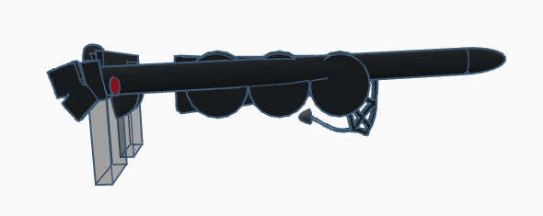
Obstacle Sensor

Slide 24
WHY?
Uneven Surface Aiding System
x

Slide 25
HOW?

Slide 26
START
Ultrasonic Module Sensor
Search for Obstacles
If Obstacle Found
Calculate the distance from the obstacle & save it
Get x cm
Using pyttsx3 module, read “UNEVEN SURFACE AHEAD”
If POWER BUTTON
STOP
If distance within range {x-5cm, x+5cm}
Find the distance between Obstacle and sensor
POWER BUTTON
yes
no
yes
no
no
yes
POWER BUTTON

Slide 27
Obstacle Sensor

Slide 28

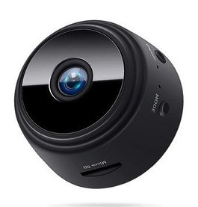
WHY?
Emergency Photo Service

Slide 29
HOW?

Slide 30
START
Video Camera is accessed via open CV
If
EMERGENCY BUTTON pressed
Save File as Emergency .png
If power button pressed
STOP
NO
NO
NO
NO
YES
YES
POWER BUTTON
POWER BUTTON

Slide 31
#FOR CAPTURING EMERGENCY PIC AND SAVING import time emergencypic = cv2.videocapture(0) a = 0 while True : a = a +1 check , frame = emergencypic.read() cv2.waitKey(0) frame.png("emergency pic") if key == ord("EMERGENCY BUTTON") #THE SECOND RED BUTTON

Slide 32
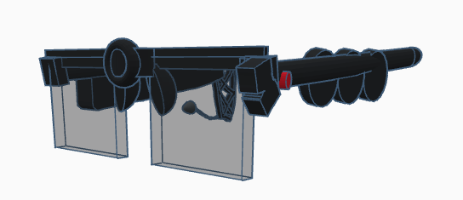
Camera
Emergency Button

Slide 33


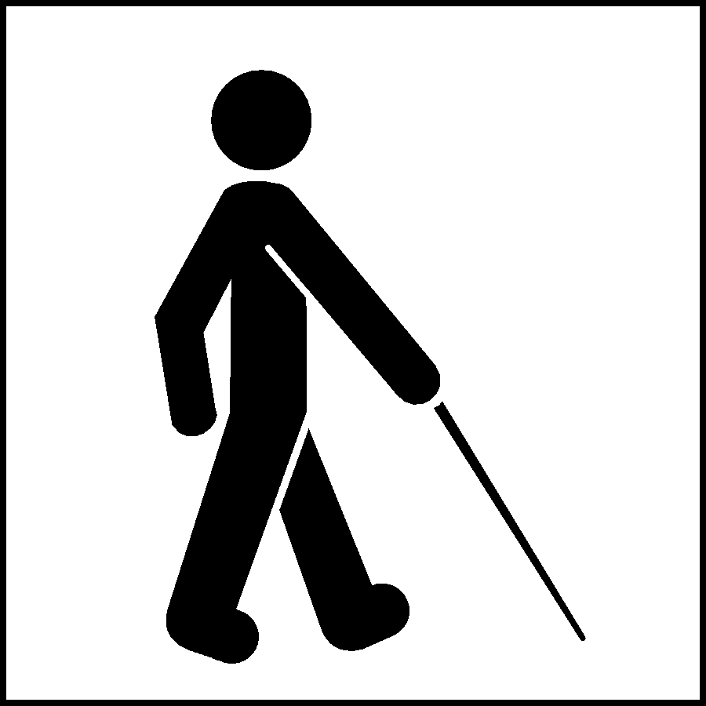

WHY?
Audio Assistance

Slide 34
HOW?

Slide 35
Using ”pyttsx3” library module in python , the text read or pre written are converted to speech and dictated via the earphone capsule

Slide 36
Earphone

Slide 37
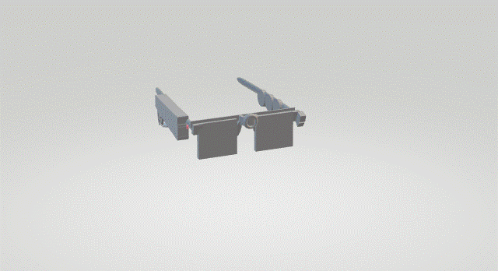

Slide 38
WHAT MAKES THIS SPECIAL?
Stand Alone device, no internet required, can be used anywhere on earth
Battery in every hour gap, user will be informed about charge left
There is also an option to warn when the charge of the device falls below 25% every 15min.
Wi-Fi and Bluetooth are High-Charge consuming, so we are avoiding them to increase battery life.

Slide 39
Why this conventional shape?
Dimensions : 15cm*15cm*5cm
weight equally balanced
battery case exposed but covered so to replace battery with charged spare if couldn't be charged on time
keeping front lens unoccupied so as to prevent complete strain on facial muscles

Slide 40
References
https://www.youtube.com/watch?v=KZBVjgwhlXY&list=PLzgdk6MxkxrLHQdy-lGeaxFArIz7SvHIf&index=1&t=232s
https://www.youtube.com/watch?v=atH0RJN-ODs&list=PLzgdk6MxkxrLHQdy-lGeaxFArIz7SvHIf&index=2
https://www.youtube.com/watch?v=cP93Uw0wVyE&list=PLzgdk6MxkxrLHQdy-lGeaxFArIz7SvHIf&index=3
https://www.youtube.com/watch?v=d3DJqucOq4g&list=PLzgdk6MxkxrLHQdy-lGeaxFArIz7SvHIf&index=4&t=956s
https://www.youtube.com/watch?v=-nHncxpN_Qc
https://www.youtube.com/watch?v=01sAkU_NvOY

Slide 41
THANK YOU

